Slide 1
IPO underpricing
Brandon Parmanand
Business Strategy

Slide 2
CONTENTS
Introduction
Dataset
Data Exploration
Modeling
Conclusion

Slide 3
INTRODUCTION
The purpose of this data project is to utilize a multiple linear regression model to provide insights into underpricing in IPOs.

Slide 4
What is an ipo?
Initial Public Offering (IPO) – private company listing their shares publicly
Traditional or Spin-off
Traditional, Special Purpose Acquisition Company (SPAC), Direct Listing
Underpricing - what occurs when the issued price is lower than the closing price on the IPO date
Notes:
Spin-offs are usually part of corporations doing some restructuring with regards to the new spinoff company having a better chance of being more profitable alone. I would expect that spin-offs have a greater chance of being underpriced than IPOs due to the status of the parent company can drive investors toward it.

Slide 5
Dataset
1996 Observations of 443 variables
Underpricing dependent variable created
26 variables selected through minor data exploration and financial theory including

Slide 7
Initial variables

Slide 8
Removed variables
Removed to keep focus at single point in time look at underpricing
Removed due to NAs or duplicates or no data

Slide 9
Summary Stats

Slide 10
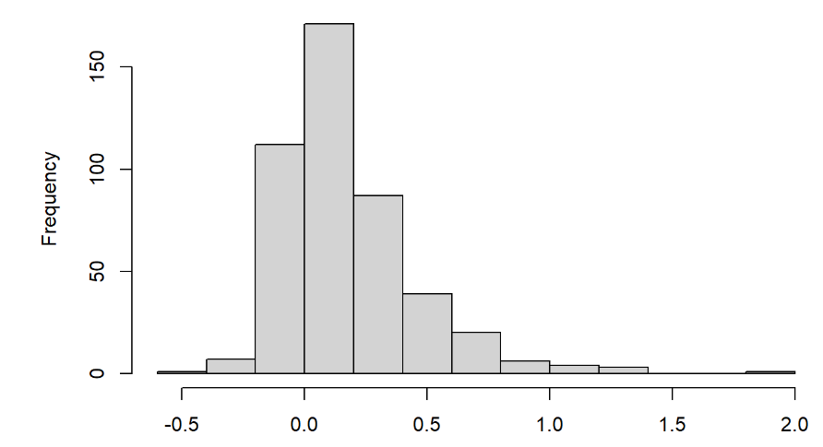
Histogram of underpricing
Notes:
Slightly skewed but still see the bell curve

Slide 11
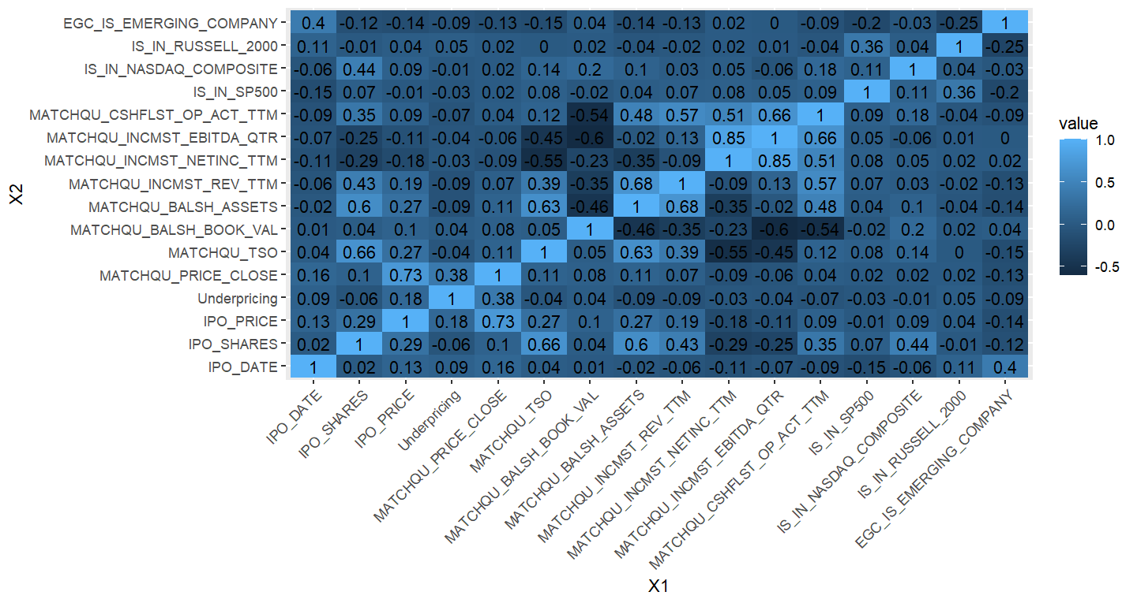
Correlation
Notes:
Removed EBITDA due to highly correlated with net income concerned about having

Slide 12
Modeling
Running regression model with all remaining 18 variables
R-squared 0.4676
Running OLS stepwise models to reduce variables and bring statistically significant model
R-squared 0.4657
Notes:
Concerns include not enough instances of IPO types and IPO Chose forward stepwise model over the backward model and original 18 variable model due

Slide 13
Final Variables
Notes:
Some con

Slide 14
Conclusion
Low R-squared of .46 does not make a great model
Spin-off IPOs have strong correlation to underpricing with p-value of 0
State of business can be a signal of the probability of being underpriced
What to do differently
Breaking out states into region categories
Using months to see which months and IPO is issued that can indicate underpricing
Notes:
Whether it is a spin

Slide 15
Questions?

